Slide 1
OOPS
OBJECT ORIENTED
OBJECT ORIENTED
PROGRAMMING SYSTEM
PROGRAMMING SYSTEM
By Shivam Sharma

Slide 2
03
INTRODUCTION TO OOPS
05
CLASS & OBJECTS
LIST OF CONTENTS
06
FOUR PILLARS OF OOPS
07
ENCAPSULATION
08
ABSTRACTION
09
INHERITANCE
13
POLYMORPHISM

Slide 3

introduction to
OOPS
Object-oriented programming aims to implement real-world entities like inheritance, hiding, polymorphism, etc. in programming. The main aim of OOP is to bind together the data and the functions that operate on them so that no other part of the code can access this data except that function.

Slide 4
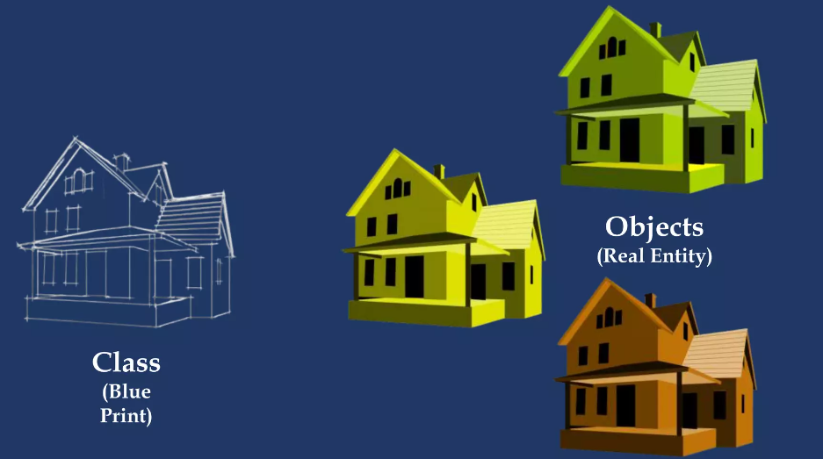
CLASS
User defined data type, which holds its own data members and member functions.
Used to define properties/behaviour of objects.
OBJECTS
Objects are an instance of a class.
When a class is created no memory is allocated, memory allocation done only when object is initialised.
READ MORE

Slide 5
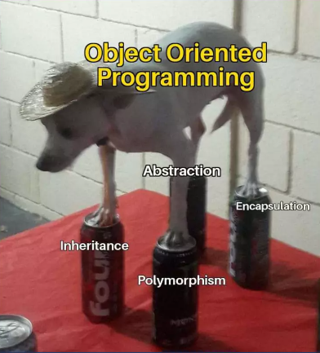
four pillar
OF OOPS
01
Encapsulation
02
Abstraction
03
Inheritance
04
Polymorphism
READ MORE

Slide 6
ENCAPSULATION
The meaning of Encapsulation, is to make sure that "sensitive" data is hidden from users.
To achieve this, you must declare class variables/attributes as private (cannot be accessed from outside the class).
If you want others to read or modify the value of a private member, you can provide public get and set methods.
There are 2 types of access modifiers available in C++
01
Public
The public members of a class can be accessed from anywhere in the program using the direct member access operator (.) with the object of that class.
02
Private
Only the member functions or the friend functions are allowed to access the private data members of the class.

Slide 7

ABSTRACTION
Only showing the user/outer world, what is need and hiding other important informations.
ENCAPSULATION VS ABSTRACTION:
Abstraction is basically a thought process of showing what is needed (basically showing only relevant data).
Encapsulation on the other hand is actually bringing down complexity by hiding data. In other words, Encapsulation implements Abstraction.

Slide 8
INHERITANCE
TYPES OF INHERITANCE
Capability of a class to derive properties from other class.
01
Single Inheritance
A class is allowed to inherit from only one class. i.e. one sub class is inherited by one base class only.
02
Multiple Inheritance
It is a feature of C++ where a class can inherit from more than one classes. i.e one sub class is inherited from more than one base classes.
03
Multilevel Inheritance
In this type of inheritance, a derived class
is created from another derived class.
04
Hierarchical Inheritance
In this type of inheritance, more than one sub class is inherited from a single base class. i.e. more than one derived class is created from a single base class

Slide 9
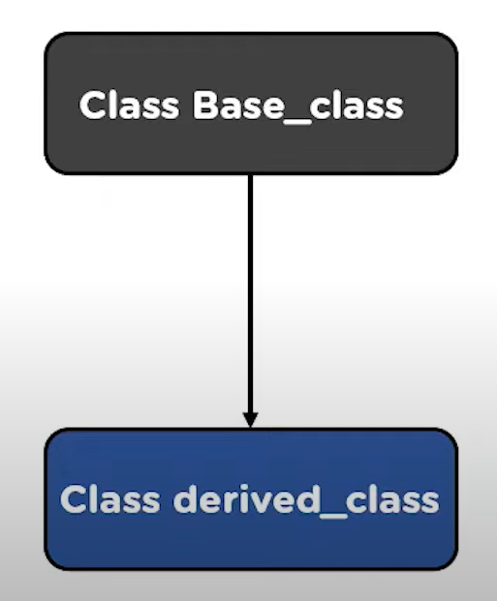
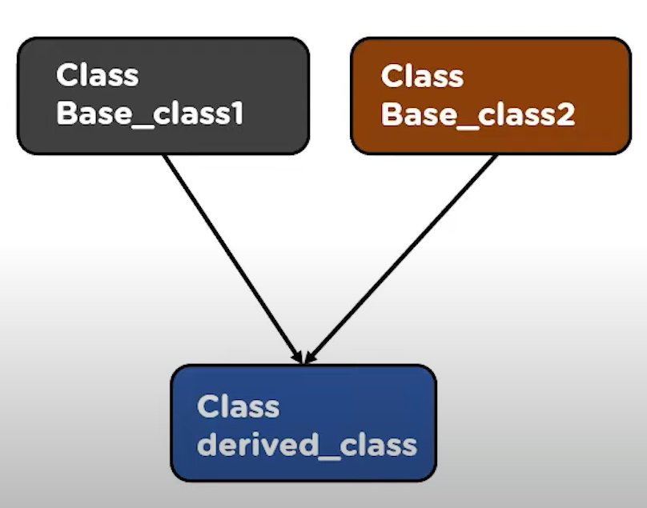
TYPES OF INHERITANCE
01
02
Single Inheritance
Multiple Inheritance

Slide 10
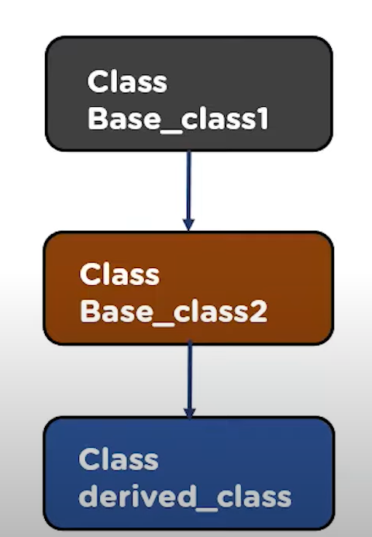
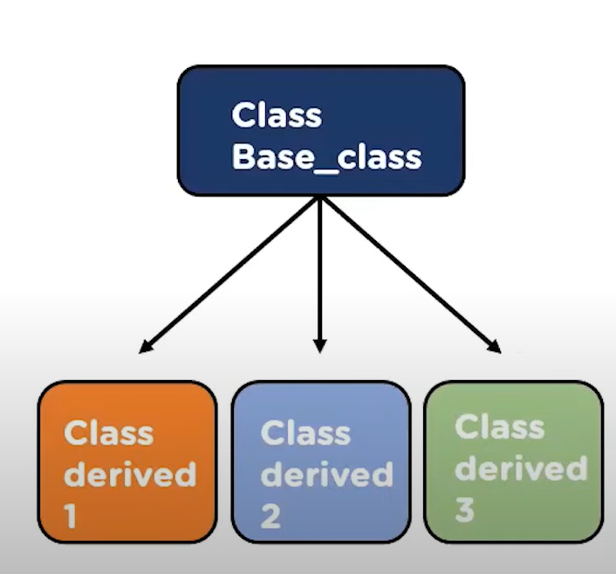
TYPES OF INHERITANCE
03
04
Multilevel Inheritance
Hierarchical Inheritance

Slide 11

POLYMORPHISM
poly: many, morph: forms. Basically, when one thing has more than one forms.
COMPILE-TIME POLYMORPHISM
RUNTIME POLYMORPHISM
01
Function
Overloading
01
Function
Overriding
02
Operator
Overloading
02
Virtual
Function

Slide 12
THANKS
FOR WATCHING
Shivam Sharma
+919569314877
sshivam22@iitk.ac.in

